Slide 1
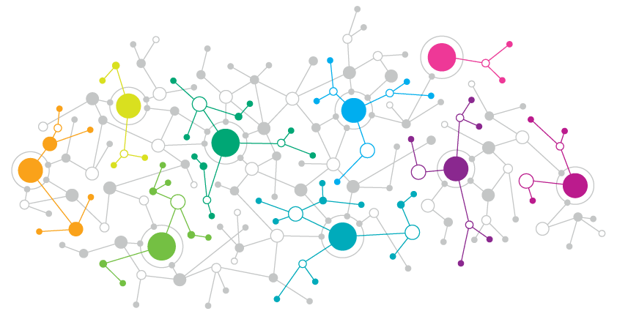


A VERY VERY VERY BRIEF AND SUPER SUPER SUPERFICIAL OVERVIEW OF COMPUTATIONAL COMMUNICATION SCIENCE
Ryan Y. Wang
Notes:
Computational social science is just a hot term out there. It is exciting due a lot of opportunities but also a lot of challenges. Today I am just giving a brief overview about what we can do with it. Each topic could be a class for a whole semester. I am not expecting you nail all the terms, all the methods that I mention later. But I do want you to be more familiar with some of the terms.

Slide 2
ROAD MAP
WHAT IS CCS?
HOW TO UTILIZE THE DATA?
WHAT DATA IS OUT THERE?
Notes:
One of my example

Slide 3
WHAT IS CCS?
Communication as a field has put less emphasis on methodologies
“lack of methods for the study of [communication] process and adoption of approaches from other fields” (Poole, 2007, p.181)
Definition of Computational Communication Science (if we ever need one)?
“An application of computational science to questions of human and social communication” (Hilbert et al., 2019)
A subfield of Computational Social Science (Lazer et al., 2009)
van Atteveldt & Peng (2018)
large and complex data sets;
consisting of digital traces and other “naturally occurring” data;
requiring algorithmic solutions to analyze;
allowing the study of human communication by applying and testing communication theory.

Slide 4
WHAT DATA IS OUT THERE?
DIGITAL TRACE DATA
ADMINISTRATIVE RECORD
Tax records
School records
Phone call records
…

Slide 5
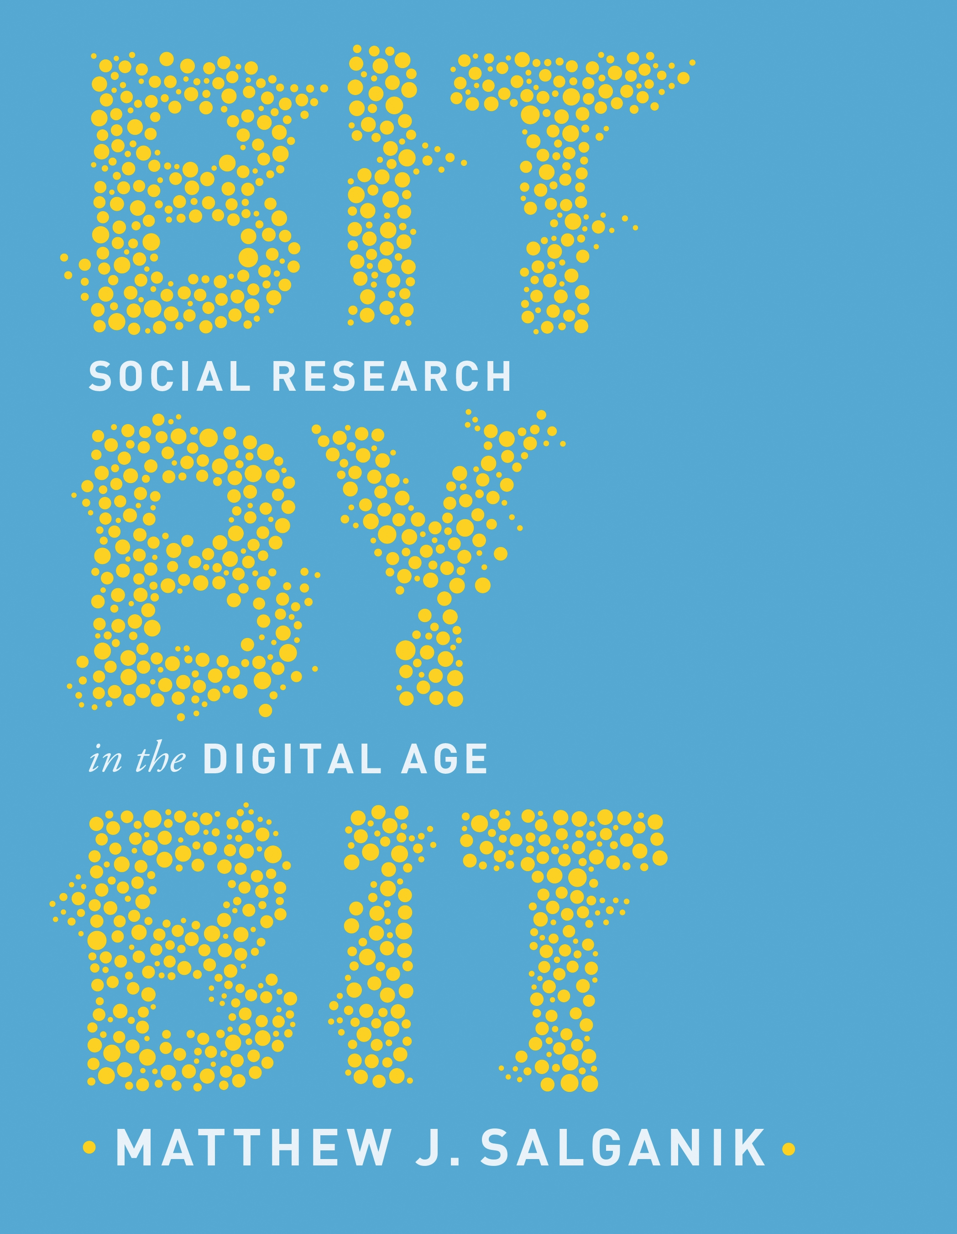
WHAT IS DIGITAL TRACE DATA?
Notes:
The manifesto of Computational Social Science. If there is one book I would suggest everyone in social science to read about big data or computational social science, I will recommend this one.

Slide 6
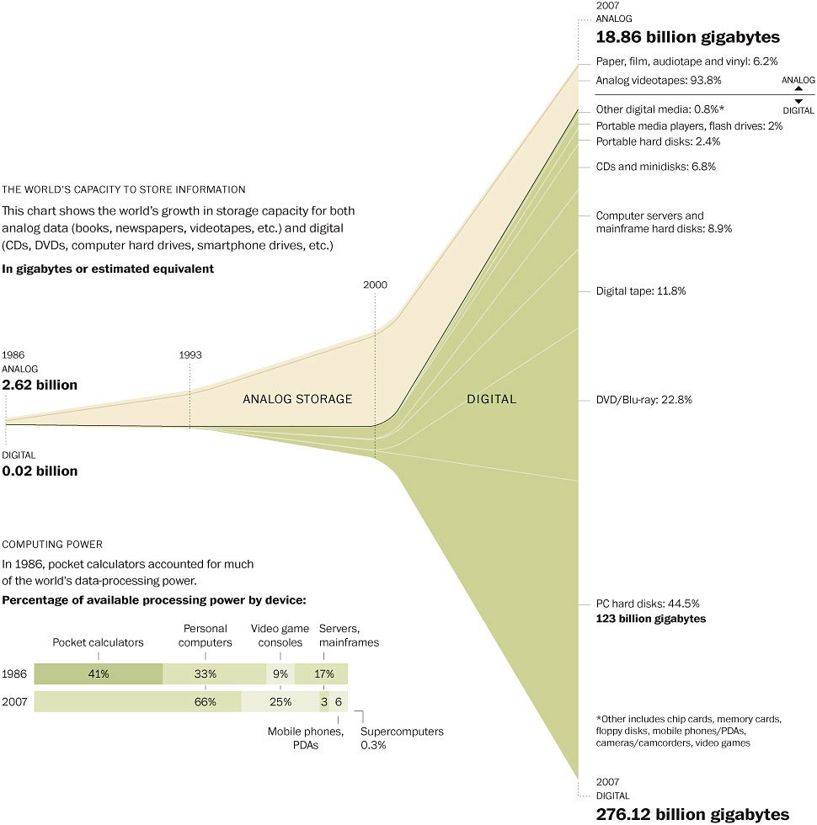
BIGNESS
ALWAYS-ON
NONREACTIVE
Source: Hilbert & Lopez (2011)
Notes:
Bigness: after the entering the digital era, the storage of data, and computing power has increased exponentially. How big would you consider big? The term itself is quite fuzzy to some extent since everyone is using it. Big Data, it is commonly stated, far more than an average desktop computer can provide, with the data often stored in the cloud across several servers and locations. However, when we are using the term, it was not quite big. Be cautious when you are using the term. Sometime because it means it requires more computing power than usual.
Always-on: Always-on big data enables that the study of unexpected events and real-time measurement (social movement; social media usage during public crisis; traffic mobility change based on your GPS in your phone, it is good measure of lockdown during COVID-19)
Nonreactive: reactivity: one challenge of social research is that people can change their behavior when they know that they are being observed by researchers in a survey or experiment. The realness, or then unobtrusiveness measurement in big data sources is much less likely to change behavior

Slide 7
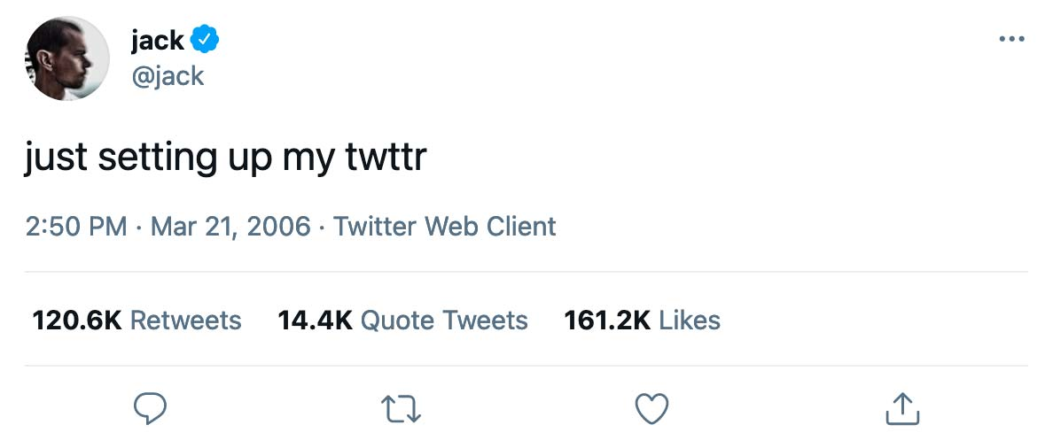
WHAT KINDS OF DIGITAL TRACE DATA?
Notes:
What data out there?

Slide 8

WHAT KINDS OF DIGITAL TRACE DATA?

Slide 9
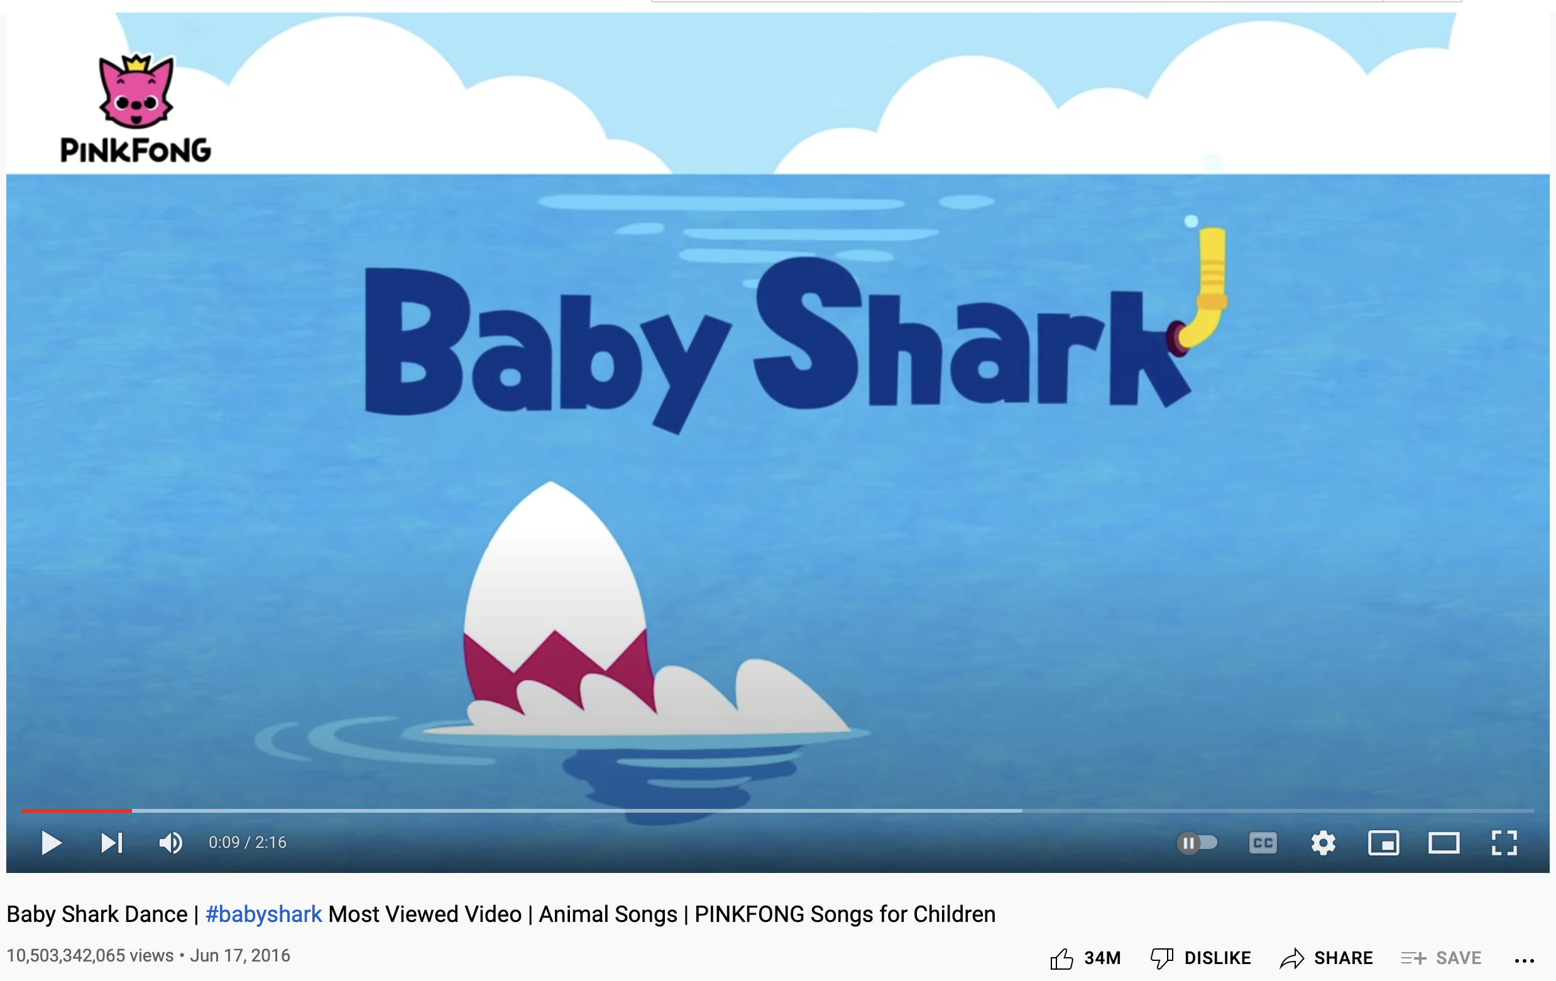
WHAT KINDS OF DIGITAL TRACE DATA?

Slide 10
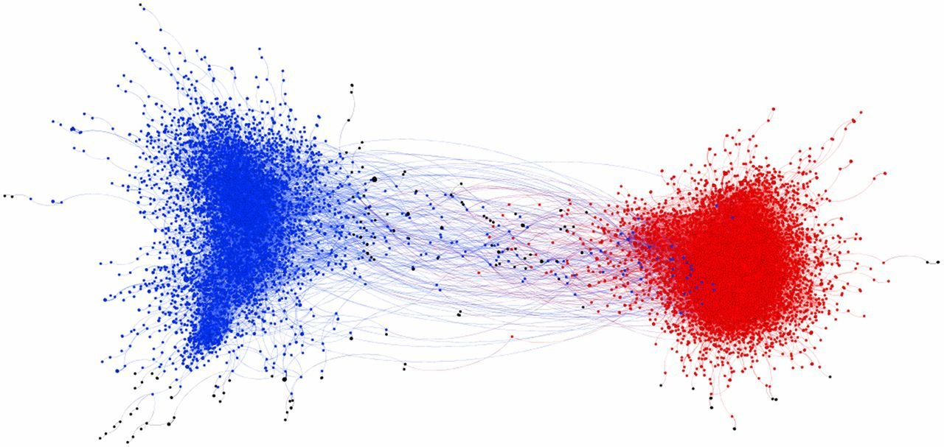
WHAT KINDS OF DIGITAL TRACE DATA?
Source: Brady et al., 2017
Notes:
We have engagement or interaction

Slide 11
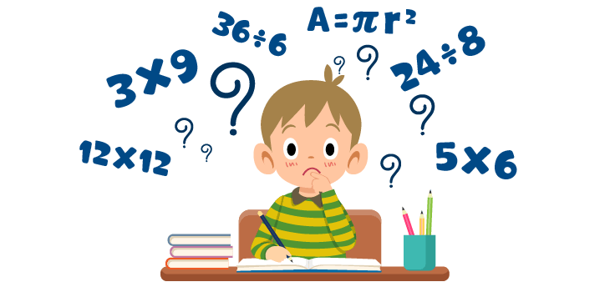
HOW CAN WE UTILIZE DIGITAL TRACE DATA?
MACHINE LEARNING???!!!

Slide 12
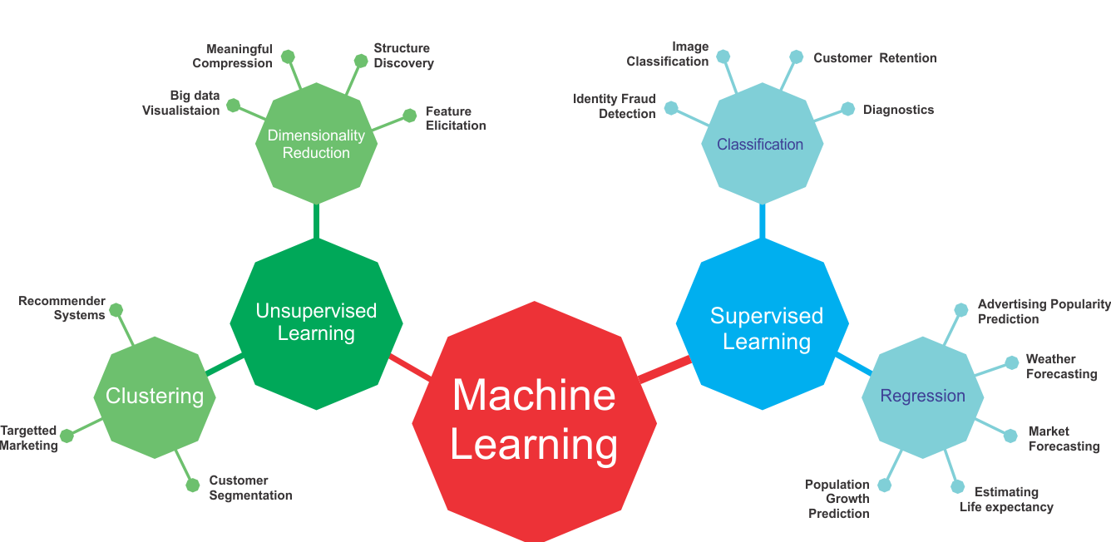
HOW CAN WE UTILIZE DIGITAL TRACE DATA?
Notes:
Unsupervised: dimension reduction – Principle component analysis. Let the data speak itself: Topic modeling is a way to find hidden patterns in a large collection of documents or texts.
Supervised machine learning need training data to learn the pattens. Classification (DV is binary variable, text – spam or not spam; image – dog or cat) and regression (DV is a continuous variable, stock market price, weather).
That is why we need annotation or labelled data (content analysis). You trained it, you tested it and you applied it to the rest. The large language model, or imagenet, I believe we all have been the annotators – when you guys log in some website, the website tests you whether you are a robot or not.

Slide 13
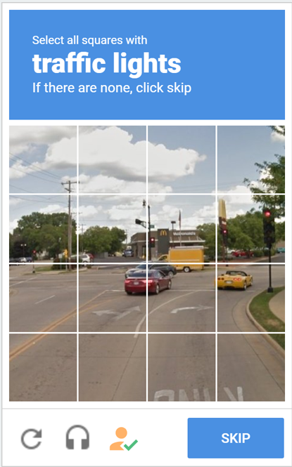
HOW CAN WE UTILIZE DIGITAL TRACE DATA?
Notes:
Capcha test

Slide 14


Unsupervised
Supervised
Notes:
Codebook; Human annotation

Slide 15
HOW CAN WE UTILIZE DIGITAL TRACE DATA?
MEASUREMENT
Automatic content analysis
INFERENCE
Explanatory modeling
Predictive modeling
Zero-shot
One-shot
Few-shot
Notes:
Content analysis: codebook – good training data
A zero-shot model is a machine learning model that can recognize objects or categories it has never seen before, without any additional training or examples. It is like a person who can recognize a new type of animal they have never seen before, just by using their knowledge of other animals and their characteristics.
Fine-tuning. A one-shot model is a machine learning model that can recognize objects or categories with only one example or training example. It is like a person who can recognize a specific breed of dog after seeing it only once, by using their knowledge of other dog breeds and their characteristics.
GPT
Differences in the field: We pay less attention into developing the algorithm but some scholars also start to get involved.
Explanatory modeling (tree-based modeling, extract the most important feature (feature selection):
Statistical model is careful operationalization of theory
Parameter estimates are the objects of interest
Statistical model itself is the object of interest.
Variance less important than bias
Predictive modeling – forecasting (CDC: COVID-19)
Objects of interest are the variable values.
Statistical model chosen to produce best predictions.
Model does not necessarily correspond to any theory
Prediction is typically prospective
Variance possibly more important than bias

Slide 16
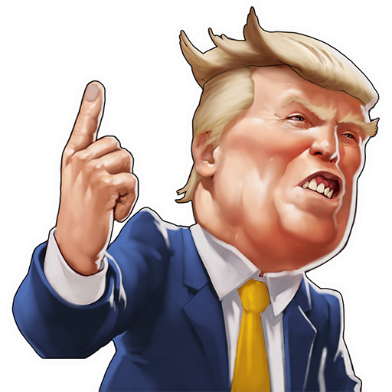

THE TOXICITY OF ‘CHINESEVIRUS’

Slide 17
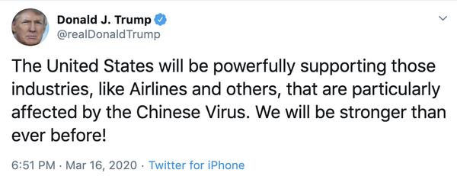
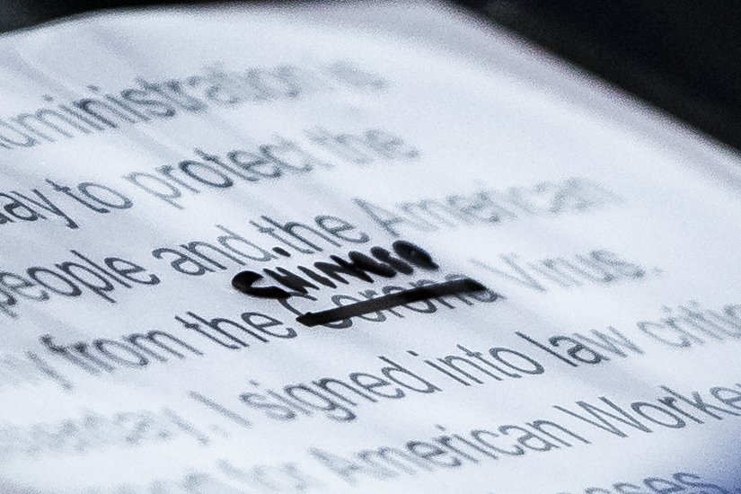

TRUMP & ‘CHINESE VIRUS’
Notes:
During the COVID-19 global pandemic outbreak, amid the emergency state, how to name the virus has become an issue beyond public health, U.S. politicians like then-President Donald Trump insisted on using terms like “Chinese virus”, “Foreign virus” and “Kung-flu” as well. Meanwhile, scholars and critics have condemned the U.S. politicians are playing the blame game while failing to deal with the public crisis; meanwhile, the terms they insisted to use could stigmatize a specific place or people or as a racial slur. As a few research has brought up, the prevalence of hateful or offensive language online has been growing rapidly in recent years, which could be transferred to offline racist harassment, physical violent attacks, and even vandalism targeting Asians and people of Asian descent have spiked in the wake of the pandemic.
Among all the cases, the tweet using “Chinese virus” posted by Donald J. Trump on March 16th was one of most controversial spices intensified the public sphere, even though he claimed to stop using the term during an interview with Fox News on March 24th.
This presentation is focusing on exploring the users in the Twitterverse who are using the term of “Chinese virus” especially after Trump’s tweet, and how might the average volume of toxicity be impacted by the so-called Trump effect here.

Slide 18

DATA COLLECTION
Keyword
“Chinese virus”, “Chinesevirus”
Time
March 12th - 25th, 2020
Original dataset
491,676 tweets
Toxicity score on hours (306)
Final dataset
Notes:
Twitter API 1.0. Network analysis based on tweets collected after Trump’s tweets; Toxicity detection is based on tweets on March 12th-25th.

Slide 19
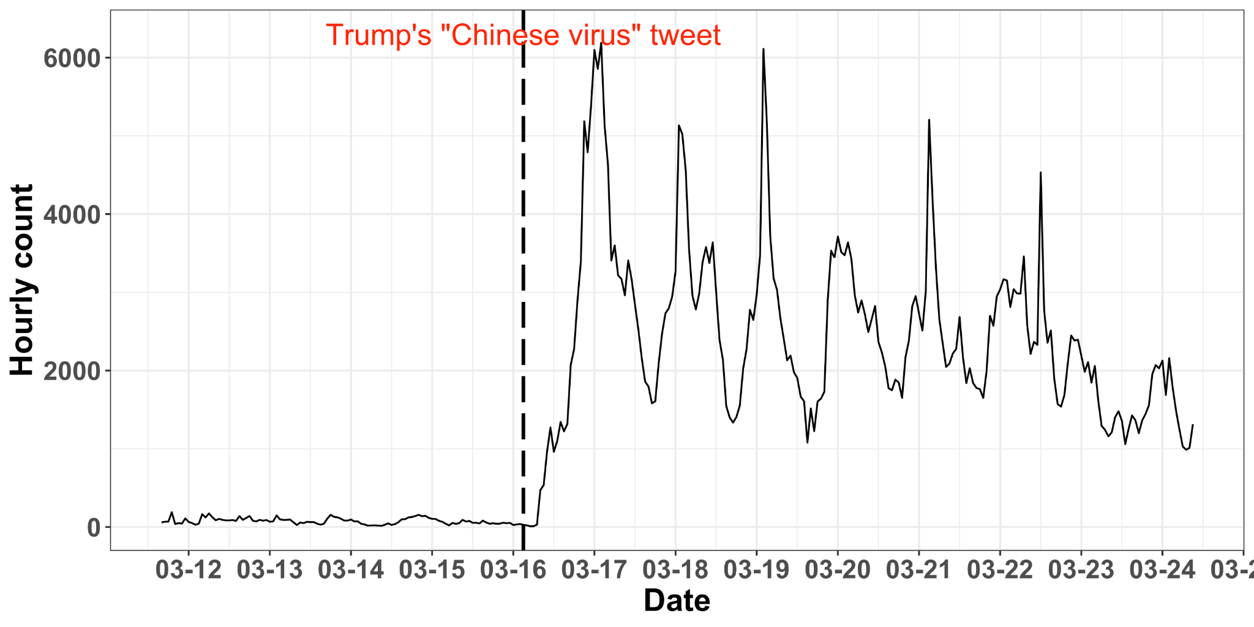
‘Chinese virus’ tweets over time
Notes:
Here we present a time series plot for the number of tweets across March 12-25th. We can clearly see up until Trump’s tweet, the total number wasn’t high at all. Donald Trump’s tweet indeed aggravated the Twitterverse to to bring up the term on the surface.

Slide 20
Is there a Trump effect on toxicity?
Trump political rallies in 2016 presidential election were found associated with a limited size but significant rise in the likelihood of reported hate and bias incidents (white-supremacist propaganda, anti-Semitic incidents, and extremist behaviors, Feinberg et al., 2022)
Notes:
High-profile individuals can affect consequential pro-social behaviors like interest in preventative health care (Tom Hanks) and voting (Taylor Swift), but it could also have a vicious one. The first layer: Incivility/toxicity from political elites has risen in recent years: negative campaign

Slide 21
The (possible) mechanism of Trump effect
Affordance theory on Twitter
Affordances are “possibilities for action ... between an object/technology and the user that enables or constrains potential behavioral outcomes in a particular context (Evans et al., 2017).
De-individualization (Spears et al., 2002 )
Network amplification of toxicity
“The contribution of social media publics to the attention paid to a particular object (Zhang et al., 2018, p.2)
Elite actors still stand on the top rung of the hierarchy, and the that amplification power on social media is also unevenly distributed (Zhang et al., 2023)
The emboldening effect: whereby individuals' determination of morally acceptable speech or behavior is influenced by the behavior they observe from elites (Newman et al., 2020).
The othering effect: Trump’s words heightened perceived differences of marginalized Asians/Asian Americans (Grover et al., 2020; Reny & Barreto, 2020).
Notes:
Second layer: Compared to Facebook or other platform, Twitter is more of a medium of sharing information with strangers and a hyper-political platform, which has a higher level of De-individuation. De-individuation was considered because it relates to people’s sense of feeling hidden within a group, according to SIDE (Spears et al., 2002). Thus, they may feel freer to perform socially undesirable behavior.

Slide 22
Research questions
Does Trump’s tweet impact the average volume of toxicity in the tweets using ‘Chinese virus’?
- Is there an upward trend of the average toxicity in the tweets using ‘Chinese virus’ following Trump’s tweet?
- Is there an interaction effect of increasing volume of toxicity in the tweets using ‘Chinese virus’ and also a discontinuity after Trump’s tweet?

Slide 23
Detecting the online toxicity?
Detoxify (Hanu & Unitary, 2021)
Transformer model: BERT
A multilabel toxicity classification model
Zero-shot pre-trained model based on online comments
Top Kaggle Leaderboard Score 98.86%; Detoxify Score 98.64%
Definition:
Toxicity: A rude, disrespectful, or unreasonable comment that is likely to make people leave a discussion.
Severe toxicity: A very hateful, aggressive, disrespectful comment or otherwise very likely to make a user leave a discussion or give up on sharing their perspective.
Insult: Insulting, inflammatory, or negative comment towards a person or a group of people.
Obscene: Swear words, curse words, or other obscene or profane language.
Threat: Describes an intention to inflict pain, injury, or violence against an individual or group.
Identity attack: Negative or hateful comments targeting someone because of their identity.
Notes:
Bidirectional Encoder Representations from Transformers is a transformer-based machine learning technique
Severe toxicity: This attribute is much less sensitive to more mild forms of toxicity, such as comments that include positive uses of curse words.

Slide 24
Detecting the online toxicity?
Examples:
High toxicity: It is the f***ing #chinesevirus! Well said! Some bat eating f***wit started this s*** and now I can’t watch the bloody football!!!
Another example: Donald Trump you racist donkey d*** sack of s***! Humans and nationalities are not viruses! You white colonizers came and brought smallpox and other s*** to my indigenous people Where is ur karma?! #Chinesevirus isn’t a thing! I hope the devil rams his d*** up ur a** in hell!
High obscene: You f***ing nuts! wts wrong to name the virus from china as chinese virus? You should go to Wuhan and to spread your love, moron!
High threat: I pray to go that communists all over the world die a painful death. Fuck communism! Fuck china!
Alternative example: I’m chinesevirus and I will kill all racists like you, Indian m******.
High insult: Shut the f*** up you hypocrites! This is a chinesevirus! This is a wuhanvirus! Why the h*** were you the hypocrite liberal west were silent about japaneseflu and ebolavirus? We don’t need you to patronise us about what we have to call this virus.
High identity-attack: All this is China’s fault! F*** you China! I hope all of you die if y’all would quit being nasty a** people, no one would being going through this. Imagine eating bats nasty a** people. That’s why y’all got little d****.

Slide 25
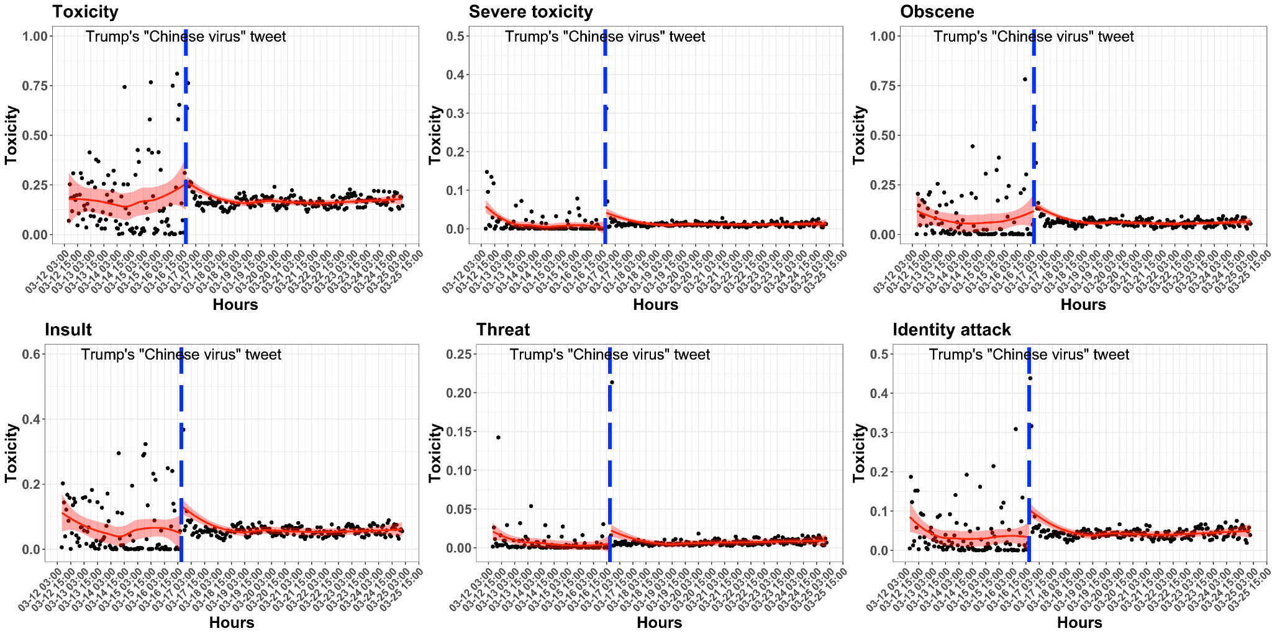
Toxicity of the “Chinese virus” tweets
Notes:
Each score was ranked between 0 and 1, we have computed scores for each single tweet and we aggregate on the hour. As we can clearly see that after Trump’s tweet, there are way more tweets from the very first time-series plot. So we also average down the toxicity based on the number of tweets in the hour as well. We can see across the six types of toxicity, there are more fluctuation before Trump’s tweet, and the toxicity volume remain comparatively consistent after the treatment.

Slide 26
Analytical strategy: Interrupted time-series analysis
Y_{t} represents the toxicity per tweet at time t
𝛽₀ sets the baseline of the volume of toxicity in the data at the starting point
T is the time since Trump posted his tweet using ‘Chinese virus’
𝛽₁ seizes the hourly pre-treatment trend while presenting the change in the volume of toxicity in the dataset per unit time increase (hour)
X_{t} is the dummy-coded factor standing for the time before or after Trump’s tweet
𝛽₂ picks up the intercept change, or the instantaneous treatment effect of Trump’s tweet
X_{t} T is an interaction term and 𝛽₃ contributes to capturing the slope change of volume of toxicity following Trump’s tweet, in comparison to the pre-treatment period
T² and X_{t}² as the quadratic terms to complement the non-linear trend in the data which would be ignored in a standard OLS ITSA model
Notes:
Interrupted time- series analysis is a powerful quasi-experimental design for assessing the longitudinal impact of an event or intervention. Beside the treatment effect, we are also interested in the so-called pre-treatment trend, as the the change in the volume of toxicity in the dataset per unit time increase. And also the so-called slope change.

Slide 27
ITSA model results
 | Toxicity | Severe toxicity | Obscene | Threat | Insult | Identity attack
Treatment effect | -0.024 | 0.014† | -0.002 | 0.009† | 0.028 | 0.030*
Pre-treatment trend | -0.002 | -0.001*** | -0.002* | 0.000* | -0.002* | -0.001*
Slope change | -0.004** | -0.001*** | -0.003*** | 0.000† | -0.002* | -0.002**
Pre-treatment trend² | 0.000† | 0.000*** | 0.000* | 0.000† | 0.000† | 0.000*
Slope change² | 0.000 | 0.000** | 0.000† | 0.000† | 0.000 | 0.000
Constant | 0.202*** | 0.044*** | 0.119*** | 0.019*** | 0.103*** | 0.070***
Note: †p < .1, *p < .05, **p < .01, ***p < .001
Notes:
As a quick sum-up, the Trump effect only existed in three types of toxicity:
Severe toxicity: A very hateful, aggressive, disrespectful comment or otherwise very likely to make a user leave a discussion or give up on sharing their perspective. Normally, when user use ’Chinesvirus’ it tends to be toxic. That is why not many differences before and after Trump’s tweet. However, ‘Trump effect’ still exist for the severe toxicity.
Threat: Describes an intention to inflict pain, injury, or violence against an individual or group.
Identity attack: Negative or hateful comments targeting someone because of their identity.
Only threat detects a lasting rise caused by Trump effect, as indicated by the positive shift instantly following Trump’s tweet, and the positive post-treatment slope change
The joint effect of the quadratics terms only worked for severe toxicity, which is slowly progressively increase over time
But the pre-treatment trend and the slope change might vary.

Slide 28
Key takeaways
Trump effect on toxicity did exist in the ‘Chinese virus’ case as increasing the toxicity in Twitterverse during a short frame of time
The fear and negativity that people feel in real world during the COVID- 19 pandemic which would lead to other blame, are easily transformed to an online format of hate speech, especially given Twitter is such a hyper-political platform.
Online racially inflammatory language by celebrity might cause irreversible consequences in real life targeting on marginalized population during a public health crisis (e.g., offline hate crimes ).
Notes:
Online racially inflammatory language by celebrity might cause irreversible consequences in real life targeting on marginalized population during a public health crisis. The fear and negativity that people feel in real world during the COVID- 19 pandemic which would lead to other blame, are easily transformed to an online format of hate speech, especially given Twitter is such a hyper-political platform.
The spillover effect of racially inflammatory languages from social media platforms to offline hate crimes has been identified by previous studies across various racial groups .

Slide 29
HOW CAN WE UTILIZE DIGITAL TRACE DATA?
Text-as-data
Sentiment analysis
Brand sentiment of user-generated content across five industries (Liu et al., 2017)
Consumer reactions towards Brand and Influencer-Generated CSR messages of BLM (Yang et al., 2021)
Personality detection
The congruence between personality of a brand’s Twitter account and the personality of their followers (Yun et al., 2019)
Topic modeling
The polarized discourses on Twitter about Gillette’s campaign on toxic masculinity (Xu & Xiong, 2020)
The global LGBTQ CSR discourse in Fortune Global 500 companies’s annual report
Notes:
JOA, IJOA, PRR
IBM’s personality insight engine

Slide 30
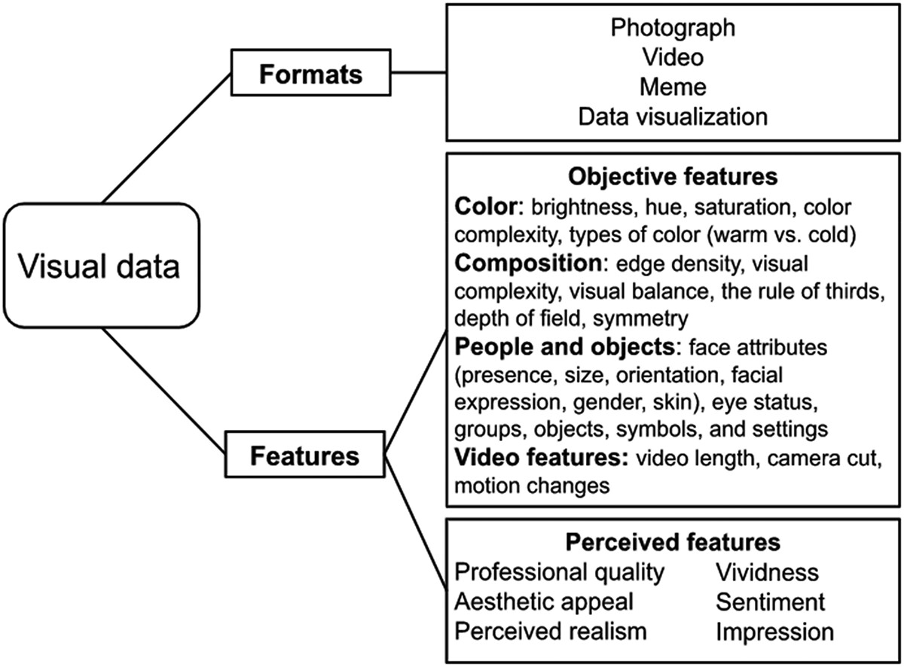
HOW CAN WE UTILIZE DIGITAL TRACE DATA?
Source: Peng et al. (2023)

Slide 31
HOW CAN WE UTILIZE DIGITAL TRACE DATA?
Text-as-data
Image-as-data/Video-as-data
Facial detection/recognition (gender, age)
The links between personalities and number of faces in the respondents’ Instagram accounts (Kim & Kim, 2018)
Emotion detection
Facial expression emotions in credibility perception of a crisis management (Stephens et al., 2019)
Visual aesthetics: brightness, contrast, composition, color, texture, blur, and complexity (image entropy)
How do the environmental characteristics (colors, luminance, and saturation, style)inspire consumers to engage in creating and posting environment-cued indirect advertising (Campell et al., 2022)
Notes:
Special issue “Image-as-data” of Computational Comm Research

Slide 32
HOW CAN WE UTILIZE DIGITAL TRACE DATA?
Text-as-data
Image-as-data/Video-as-data
Audio-as-data
Vocal pitch as measurement of emotional intensity in legislators’ speech when mentioning about women (Dietrich et al. 2019)
Notes:
Image-as-data or video-as-data: nonverbal communication. Attention in german parliement
Audio-as-data: political debate: passionate speech, tedious monologue.
Network/Graph-as-data: Node classification; Link prediction

Slide 33
NEW METHODS? OLD METHODS?
Observational research
Linking survey data and digital trace data
Notes:
Personality traits and risk perception and opinion expression

Slide 34
NEW METHODS? OLD METHODS?
Observational research
Linking survey data and digital trace data
Experiment
Virtual lab experiment (e.g., apps/web as labs: Zhang et al., 2015)
Virtual field experiment (Bail et al., 2018)
Notes:
To identify what features of social media - promotional messaging or peer networks - can increase physical activity, different types of web portal

Slide 35
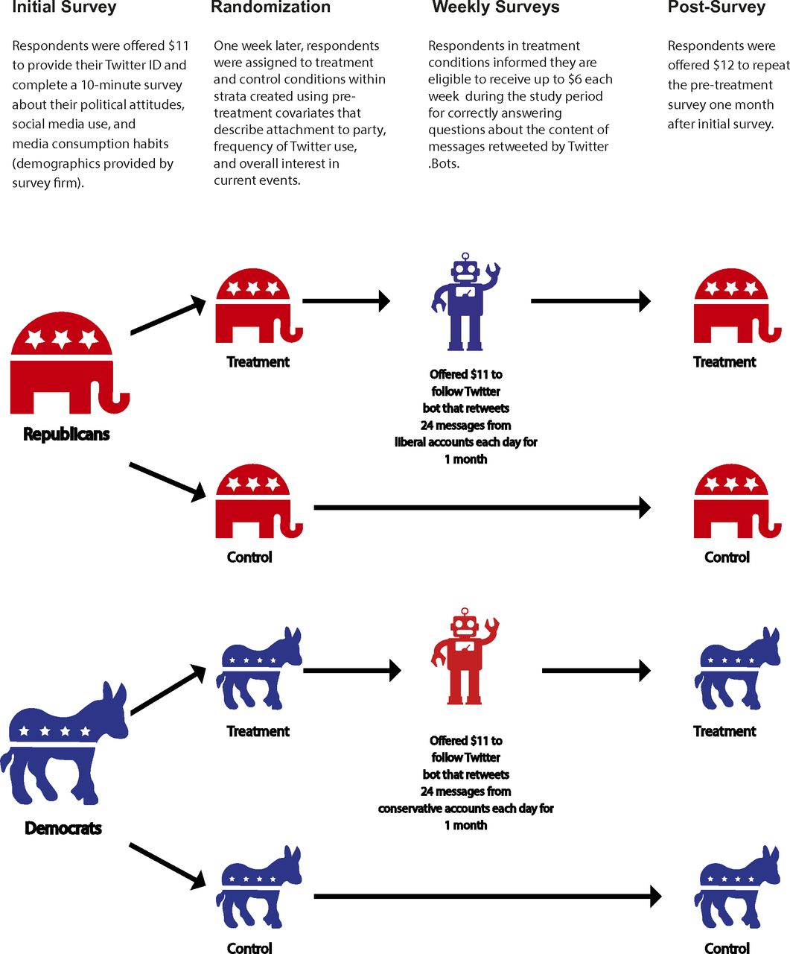
Source: Bail et al. (2018)

Slide 36
NEW METHODS? OLD METHODS?
Observational research
Linking survey data and digital trace data
Experiment
Virtual lab experiment (e.g., apps/web as labs: Zhang et al., 2015)
Virtual field experiment (Bail et al., 2018)
Multimodal data: text, image, audio
How does theory fit in?
Two-step flow model/networked-step flow model (Hilbert et al., 2017)
Framing (Chen et al., 2021)
Agenda-setting (Russel et al., 2014)
Selective exposure (Song & Boomgaarden, 2017)
Notes:
Misinformation

Slide 37
IS COMPUTATIONAL APPROACH A ONE-FOR-ALL SOLUTION?

Slide 38
INCOMPLETE
INACCESSIBLE
NONREPRESENTATIVE
DRIFTING
ALGORITHMICALLY CONFOUNDED
Notes:
Incomplete: No matter how big you data is, it probably doesn’t have the information you have (ban by twitter)
Inaccessible: Data held by companies and governments are difficult for researchers to access. Twitter in general more friendly to researcher. Facebook is hard to work with – their own portal and VPN, and they don’t really to share data. Not to mentioned TikTok (Bytedance, the parent company) and now Twitter
Nonrepresentative: Nonrepresentative data are bad for out-of-sample generalizations, but can be quite useful for within-sample comparisons. Can Twitter represent America? Not at all! Only the 22% of American adults are using Twitter. Twitter users are younger, more likely to identify as Democrats, more highly educated and have higher incomes than U.S.
Drifting makes it hard to use big data sources to study long-term trends. Population drift (change in who is using system, for instance, scholars found during the 2012 US presidential election, the proportion of tweets about politics that were written by women fluctuated from day by day), usage drift or behavior drift (for instance, the hashtags might change when protest evolves during a social movement; Trum[‘s rally hashtag flooded by the BTS army), and system drift – the system itself, engineering speaking has changed. For instance, the word length you can tweet, extending from 140 to 280 characters. It is tied with the next characteristics.
Algorithmically confounded: Behavior in big data systems is not natural; it is driven by the engineering goals of the systems. Facebook has changed their algorithm about what you can see on your own feed, and weight more on specific emotions (anger) and not based on timeline.

Slide 39
INCOMPLETE
INACCESSIBLE
NONREPRESENTATIVE
DRIFTING
ALGORITHMICALLY CONFOUNDED
DIRTY AND NOISY
SENSITIVE (POTENTIAL HARM?)
Notes:
Dirty and noisy: a lot of junk and spam. The comments you guys collected from social media, a lot of acronyms, abbreviations, slang, emojis, incorrect grammar. Data scientists are spending a lot of times in data cleaning.
Sensitive: some of the data is pretty sensitive and might cause potential harm. Netflix has a prize to call for improvement of their recommendation system. Although they anonymized the personal identification, researchers are still able to retrieve the information with external dataset (for instance, zip code, birth date, sex).

Slide 40
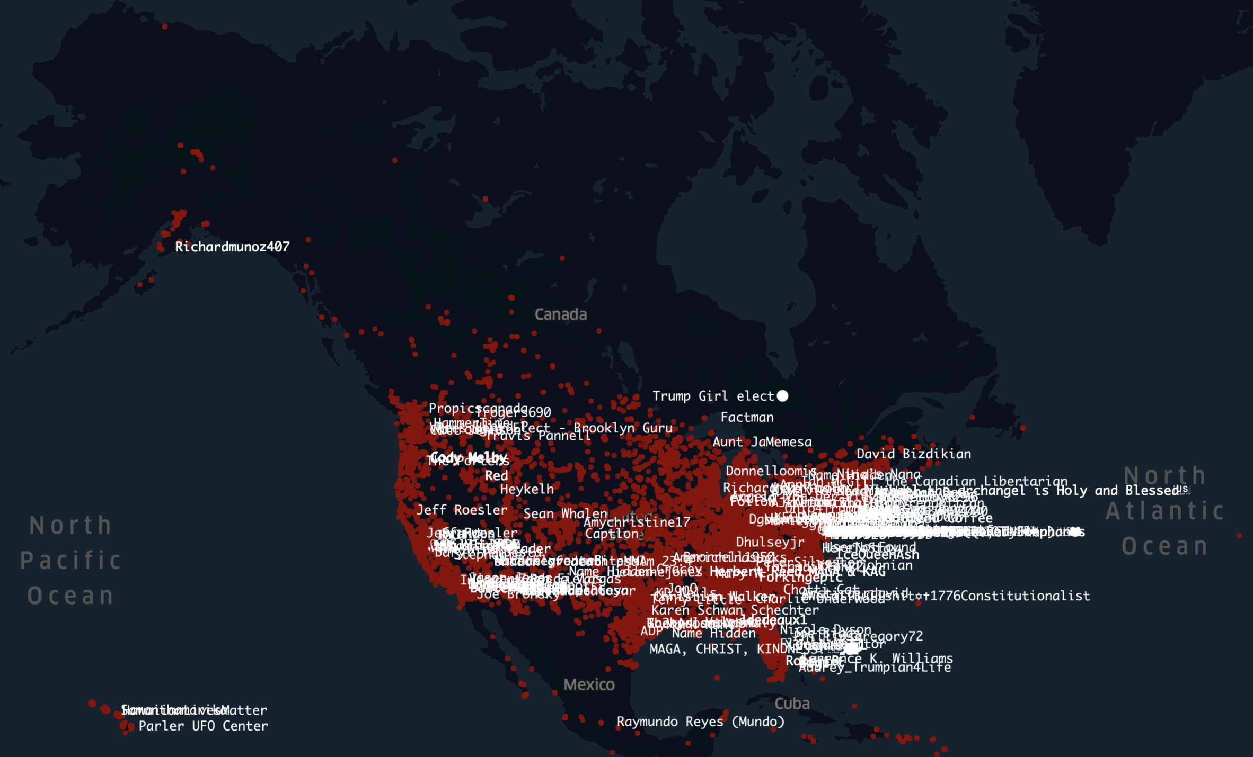
Source: McDonald (2021)
Notes:
Another case is the Parlor app – here is all the geo-locations that have uploaded video or image during January 6th Capital hill riots. Household address and attack.

Slide 41
IS COMPUTATIONAL APPROACH A ONE-FOR-ALL SOLUTION?
ABSOLUTELY NOT!
Big data hubris? “Big” data does not mean “Good” data
Valid and reliable measurement?- Validation matters
Interpretable machine learning?
The good-for-prediction vs. The good-for-explanation
Ethics
The fairness of machine learning
Algorithmic bias – annotation matters!
Notes:
computational methods do not replace the existing methodological approaches, but rather complement it

Slide 42
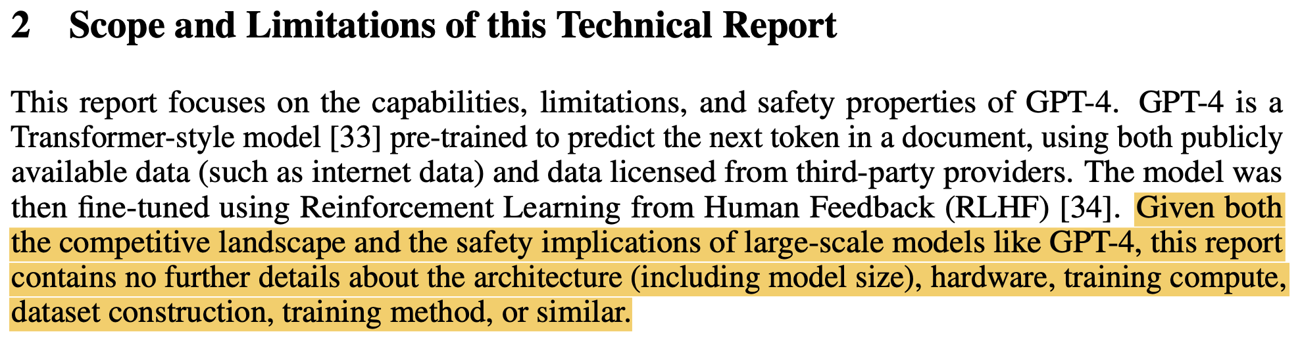
IS COMPUTATIONAL APPROACH A ONE-FOR-ALL SOLUTION?
ABSOLUTELY NOT!
Notes:
GPT-4

Slide 43
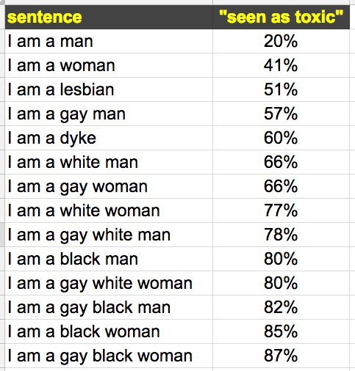
IS COMPUTATIONAL APPROACH A ONE-FOR-ALL SOLUTION?
@jessamy
Notes:
Google’s Perspective API

Slide 44

THANKS!
Ryan Wang: ryanwang@psu.edu
@ryn_wang

Slide 45
REFERENCES
Bail, C. A., Argyle, L. P., Brown, T. W., Bumpus, J. P., Chen, H., Hunzaker, M. F., ... & Volfovsky, A. (2018). Exposure to opposing views on social media can increase political polarization. Proceedings of the National Academy of Sciences, 115(37), 9216-9221. Dietrich, B. J., Hayes, M., & O’brien, D. Z. (2019). Pitch perfect: Vocal pitch and the emotional intensity of congressional speech. American Political Science Review, 113(4), 941-962.
Campbell, C., Sands, S., Montecchi, M., & Jensen Schau, H. (2022). That’s So Instagrammable! Understanding How Environments Generate Indirect Advertising by Cueing Consumer-Generated Content. Journal of Advertising, 51(4), 411-429.
Hilbert, M., & López, P. (2011). The world’s technological capacity to store, communicate, and compute information. Science, 332(6025), 60-65. Hilbert, M., Vásquez, J., Halpern, D., Valenzuela, S., & Arriagada, E. (2017). One step, two step, network step? Complementary perspectives on communication flows in Twittered citizen protests. Social science computer review, 35(4), 444-461. Kim, Y., & Kim, J. H. (2018). Using computer vision techniques on Instagram to link users’ personalities and genders to the features of their photos: An exploratory study. Information Processing & Management, 54(6), 1101-1114.
Lu, Y., & Pan, J. (2022). The Pervasive Presence of Chinese Government Content on Douyin Trending Videos. Computational Communication Research, 4(1).
Russell Neuman, W., Guggenheim, L., Mo Jang, S. A., & Bae, S. Y. (2014). The dynamics of public attention: Agenda-setting theory meets big data. Journal of communication, 64(2), 193-214.
Stephens, K. K., Waller, M. J., & Sohrab, S. G. (2019). Over-emoting and perceptions of sincerity: Effects of nuanced displays of emotions and chosen words on credibility perceptions during a crisis. Public Relations Review, 45(5), 101841.
Song, H., & Boomgaarden, H. G. (2017). Dynamic spirals put to test: An agent-based model of reinforcing spirals between selective exposure, interpersonal networks, and attitude polarization. Journal of Communication, 67(2), 256-281.
van Atteveldt, W., & Peng, T. Q. (2018). When communication meets computation: Opportunities, challenges, and pitfalls in computational communication science. Communication Methods and Measures, 12(2-3), 81-92.
Xu, S., & Xiong, Y. (2020). Setting socially mediated engagement parameters: A topic modeling and text analytic approach to examining polarized discourses on Gillette’s campaign. Public Relations Review, 46(5), 101959.
Yun, J. T., Pamuksuz, U., & Duff, B. R. (2019). Are we who we follow? Computationally analyzing human personality and brand following on Twitter. International Journal of Advertising, 38(5), 776-795.
Zhou, A. (2021). Communicating corporate LGBTQ advocacy: A computational comparison of the global CSR discourse. Public Relations Review, 47(4), 102061.

